Slide 1

Sorting Algorithm Visualizer
A web-based educational tool for visualizing sorting algorithms, ideal for computer science students and educators

Slide 2
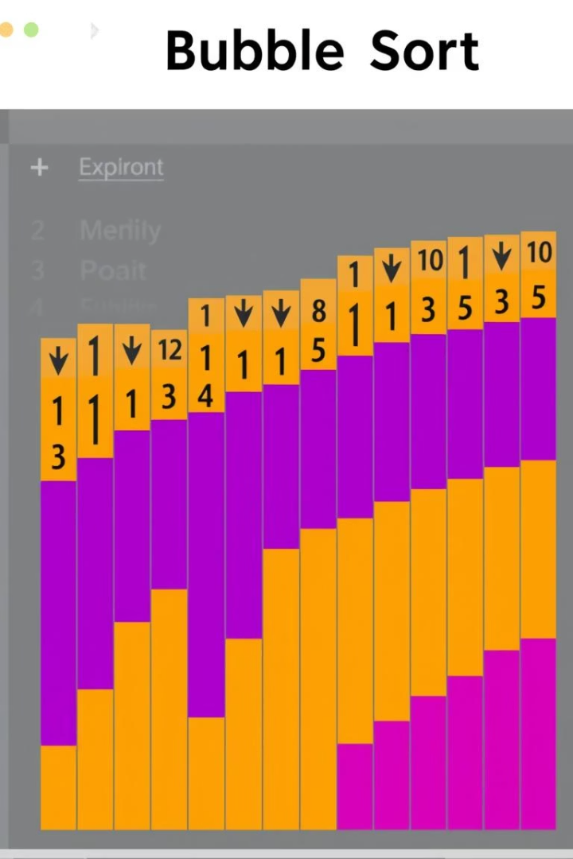
Introduction
Visual Representation
Step-by-Step
Demonstrates sorting algorithms with animations.
Shows array sorting step-by-step.
Technology Stack
Built using HTML, SCSS, and JavaScript.
This project provides visual understanding of algorithms through animated feedback and comparison.

Slide 3




Core Objectives
Interactive Platform
Create an animated platform to explain sorting methods.
Visual Feedback
Show real-time visual feedback of algorithm steps.
Algorithm Comparison
Compare different algorithms.
Objectives include building an interactive platform with visual feedback and comparative analysis.

Slide 4

Technologies
1
HTML5
Webpage structure
2
CSS3 & SCSS
Styling and animations
3
JavaScript
Algorithm implementation and control
4
VS Code
Code editor
The project utilizes HTML5 for structure, CSS3/SCSS for styling, JavaScript for logic, and VS Code for development.

Slide 5
Sorting Algorithms Included
Basic Sorts
Advanced Sorts
Bubble Sort
Merge Sort
Selection Sort
Quick Sort
Insertion Sort
Heap Sort
Implements various sorting algorithms, each in its own file under /scripts for modularity.

Slide 6
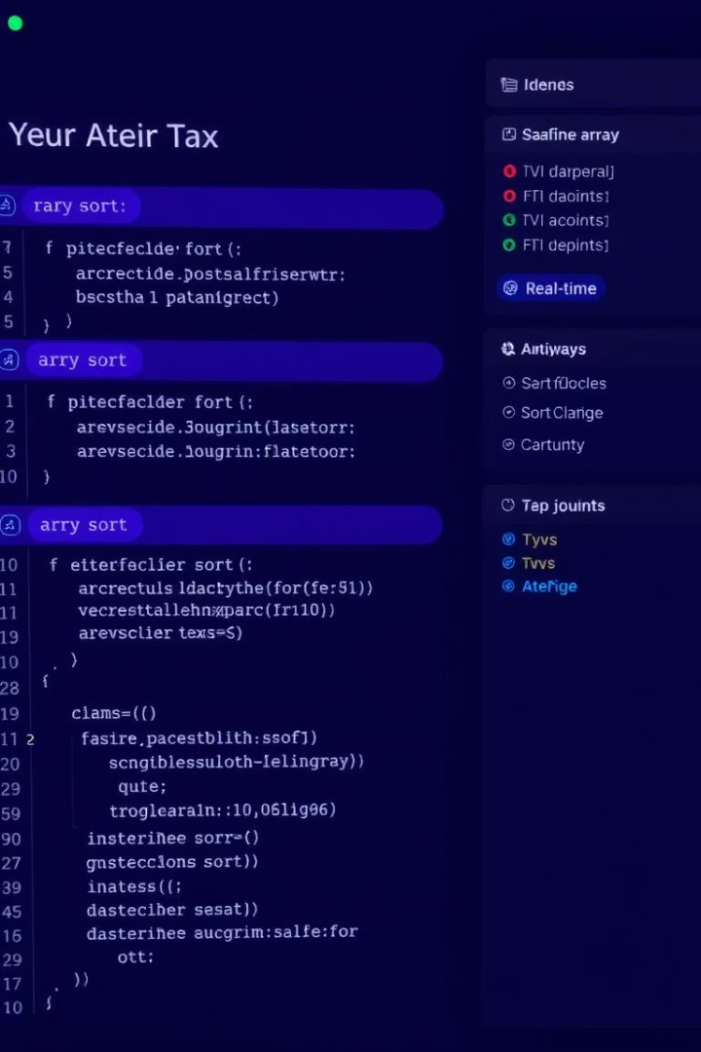



How It Works
Algorithm Selection
User selects an algorithm
Array Generation
Random array bars are generated
Step-by-Step Animation
Algorithm animates the sorting
The system allows users to select algorithms, generate arrays, and visualize sorting with time-delayed animation.

Slide 7
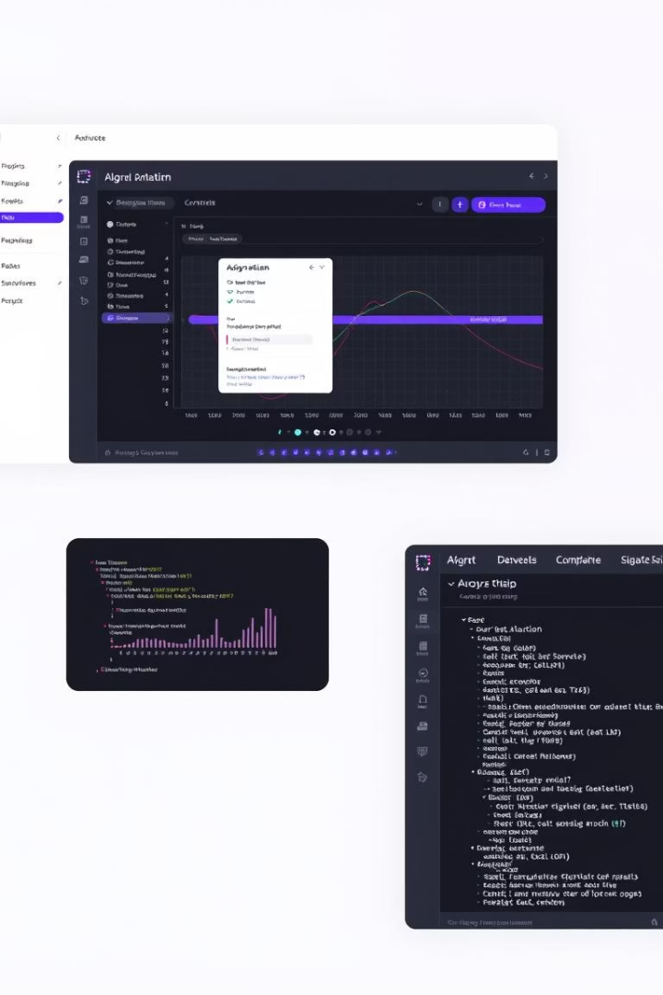




Key Features
Clean UI
Responsive layout
Smooth Animation
Sorting steps
Easy Switching
Between algorithms
Control Buttons
Speed control
Features a clean UI, smooth animations, easy algorithm switching, and available control buttons.

Slide 8

Conclusion and Future Enhancements
Effective Learning
Effective visual learning tool.
Real-Time Behavior
Demonstrates algorithm behavior in real-time.
Future Enhancements
More algorithms, user controls, analysis.
The project serves as an effective visual learning tool with potential for adding algorithms and analysis.

